Slide 1
A Dynamic Time Warping Based Algorithm to Evaluate Kinect-Enabled Home-Based Physical Rehabilitation Exercises for Older People
Xiaoqun Yu , Shuping Xiong
Department of Industrial and Systems Engineering, Korea Advanced Institute of Science and Technology (KAIST), Daejeon 34141, Korea
《 Sensors》 IF:3.510

Slide 2
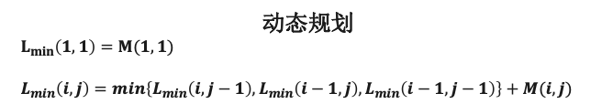
Dynamic Time Warping（动态时间规整，DTW）
目的：把两个代表同一个类型的事物的不同长度序列进行时间上的“对齐”。比如在语音识别中，同一个字母不同的人发音，长短和音调不同，但是信号是肯定相似的，只是在时间上不对齐。
DTW算法步骤
计算两个序列各个点之间的距离矩阵。
寻找一条从矩阵左上角到右下角的路径，使得路径上的元素和最小。
传统欧几里得距离
DTW对应
字母W
距离之和：6
距离之和：0
A(1)-B(1)
A(2)-B(2)
A(3)-B(3)
A(4)-B(4)
A(5)-B(5)
A(6)-B(6)
A(1)A(2)-B(1)
A(3)A(4)-B(2)
A(5)-B(3)B(4)
A(6)-B(5)B(6)
动态规划
$L_{min}\left(1,1\right)=M(1,1)$
$L_{min}\left(i,j\right)=min\left\{L_{min}\left(i,j−1\right),L_{min}\left(i−1,j\right),L_{min}\left(i−1,j−1\right)\right\}+M(i,j)$

Slide 3
Introduction
The global healthcare system is under great pressure due to rapid population aging as well as a shortage of healthcare personnel and budget.
There is strong evidence that appropriate physical rehabilitation exercises can improve physical activity level and activities of daily living of older people.
low rates of uptake and adherence due to a lack of enjoyment, inconvenient transportation, and high cost
Recently, with the emergence of more affordable motion sensors (such as Kinect and inertial sensors) and gaming technologies, the use of home-based exergame (exercise + gaming) for physical rehabilitation appears promising over passive conventional exercise therapies for the elderly with respect to long-term uptake.
not only eliminate restrictions of distance and cost to the rehabilitation center, but also allow the elderly to flexibly adjust the training schedule and exercise intensity

Slide 4
Introduction
Auto-coaching system: guide end users to follow virtual coach’s motions as well as track and evaluate their reproduced motions
However, because there is no real coach on site during the exercise, the scientific motion comparison for automatic performance evaluation is critical to guarantee the effectiveness of such a system.
Dynamic time warping (DTW): a well-known approach for measuring time-series similarity, which minimizes the effects of time lag and distortion in the time axis due to speed variation
This study aims to develop and validate a DTW-based algorithm for a motion similarity evaluation, in order to support effective Kinect-enabled home-based virtual coaching. We proposed a simple but innovative method to directly convert the DTW matching cost to a meaningful performance score in terms of percentage (0–100%), without training data and experience of experts.

Slide 5
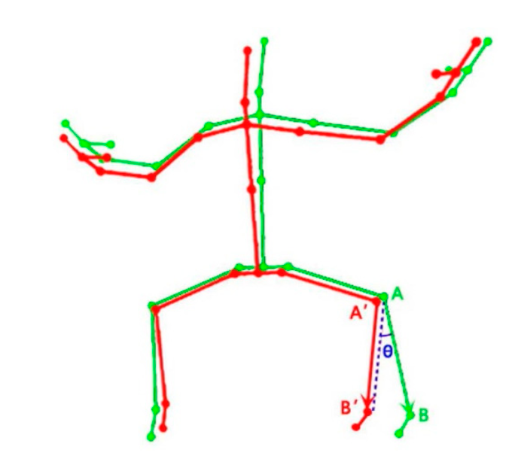
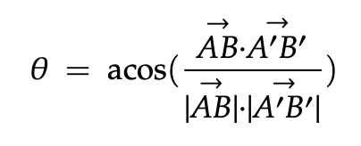
Methods
3D Pose Comparison
quantify the difference between these two 3D poses at a given frame.
eight major bones of the human skeleton (the upper and lower arms, and the upper and lower legs)
The angle difference (θ) between two corresponding bone vectors of trainer and trainee can be calculated by the law of cosine.

Slide 6
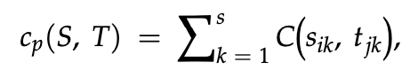
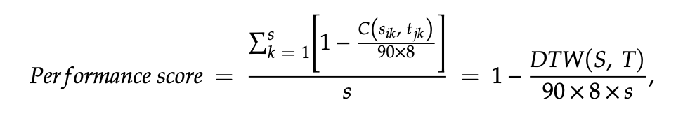
Methods
Motion Comparison
Given two sequences of motion data X and Y, each frame of motion data is a 3D pose.
We applied DTW to find the optimal matching between the trainer’s motion and the trainee’s motion while minimizing the effects of shifting and distortion in time.
The matrix of each dataset has dimension 8-by-n, where n is the total frames of motion data.

Slide 7
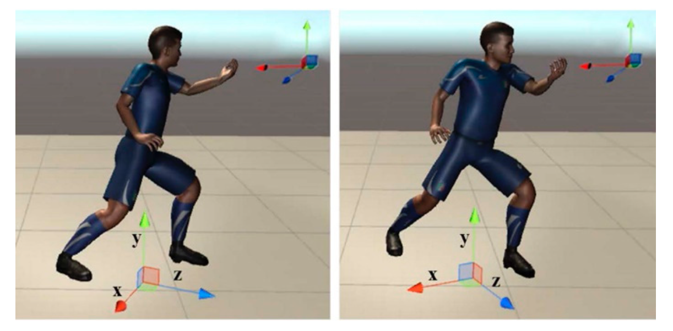
Methods
Body Orientation Offset
Calculation of bone vectors for both trainee’s motion and trainer’s motion based on the world coordinate system could be problematic if the trainee is not oriented as exactly as the trainer.
we calculate the joint position data based on a local coordinate system of the human model, which would be updated in real time.
1. The up vector is defined as middle of left/right upper arm and middle of left/right upper leg.
2. The left vector is an average upper body left (a vector defined by the left upper arm and the right upper arm) and lower body left (a vector defined by the left upper leg and the right upper leg).
3. The forward vector is the cross product of the up vector and the left vector.
4. The final left vector is the cross product of the forward vector and the up vector.
5. Then the up vector is aligned to a normal vector of a ground plane as the y-axis.
The main purpose of this step is to guarantee that the x-axis and the z-axis would always be in the ground plane. The origin of this local coordinate system is the projection of center of mass on the ground.

Slide 8
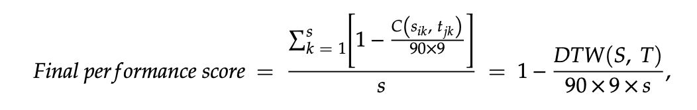
Methods
Body Orientation Offset
Calculation of angular differences based on the local coordinate system of the human model can remove the accumulative errors on eight bone vectors caused by different body orientations.
However, the difference in body orientation between trainee and trainer should also be considered in this case.
Hence, we added one more dimension-body orientation into the evaluation of motion similarity.

Slide 9
Experimental Participants
Twenty-one middle-aged and older subjects (age: 55.2 ± 4.2 years, height: 166.1 ± 7.9 cm, weight: 65.36 ± 8.3 kg) from a local Tai Chi academy participated in the algorithm validation experiment.
For the sake of convenience, the experiment was conducted in the same Tai Chi academy instead of each subject’s home.
All the subjects were in healthy conditions and without musculoskeletal diseases or injuries that may affect their Tai Chi performance.
Prior to the participation of the experiment, each subject signed informed consent on the experiment protocol, which was approved by the KAIST Institutional Review Board (IRB-18-070).

Slide 10
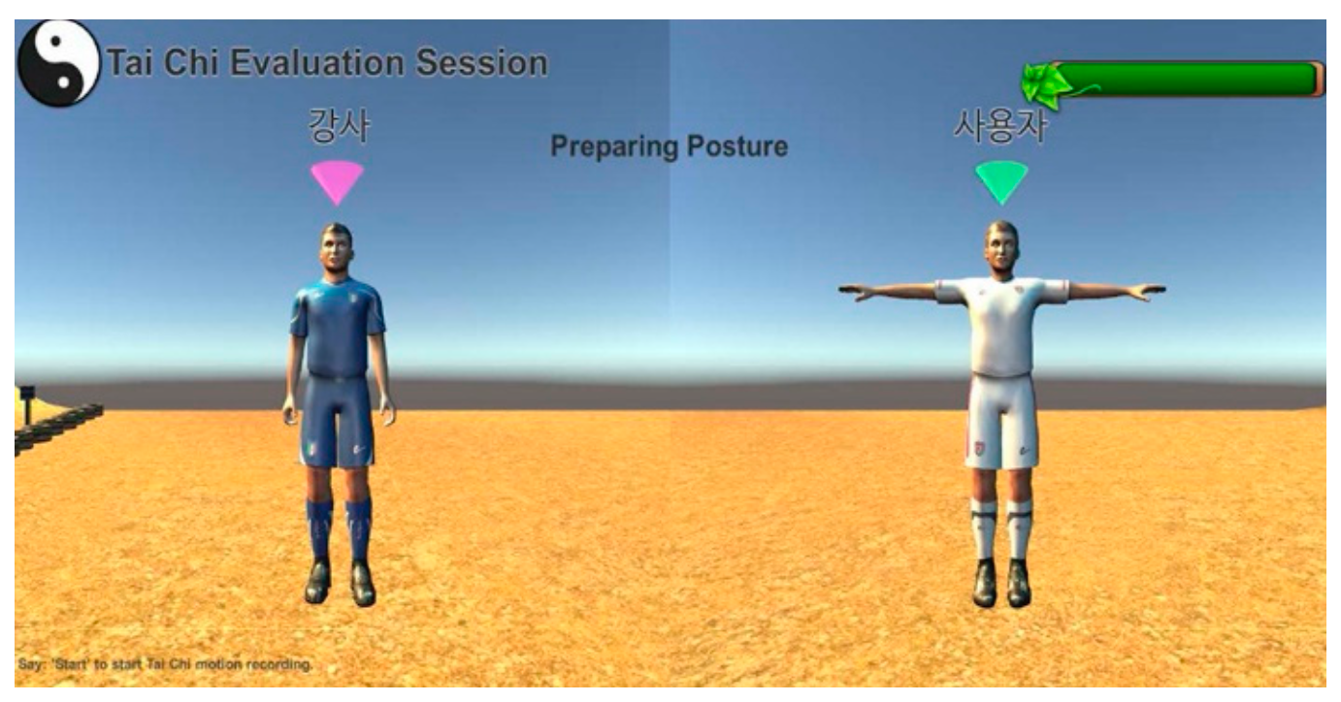
Experimental Setup and Procedure
The Tai Chi exergame was developed with Kinect V2 sensor in Unity3D platform (Unity 5.5.2f1) by C# for the real-world application.

Slide 11
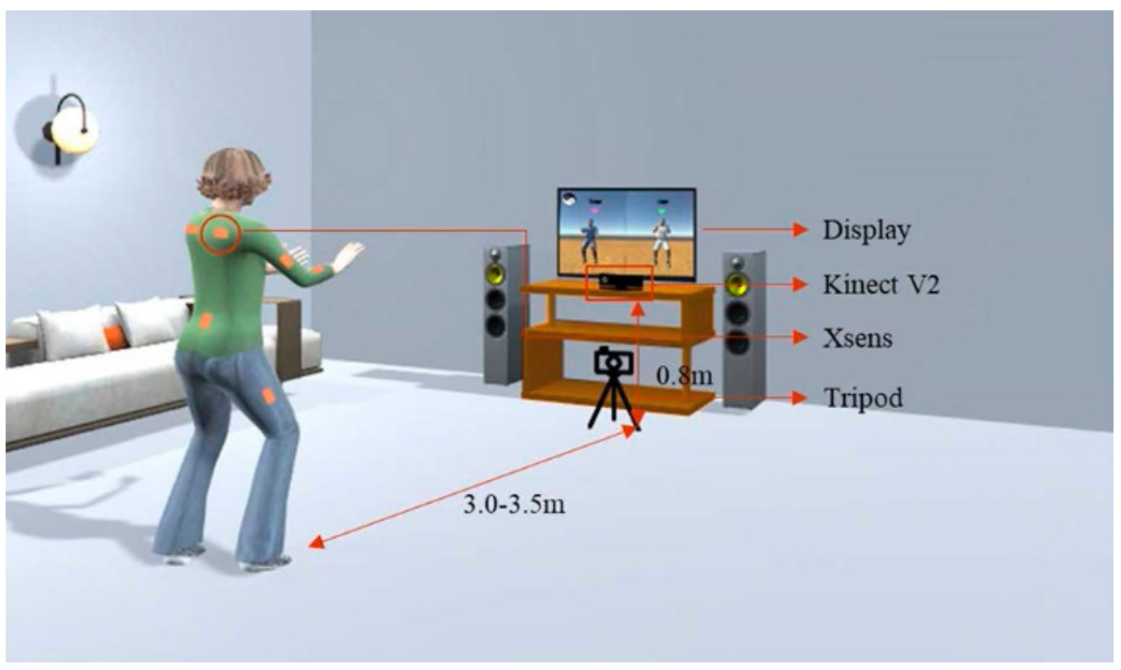
Experimental Setup and Procedure
Considering that some Tai Chi motion with body rotation may not be well captured by the Kinect due to the self-occlusion, a wearable inertial sensor-based motion capture system-Xsens was also utilized to obtain high-quality motion data for the algorithm validation.
A smart phone, supported by a tripod, was used to record each subject’s motion when he/she was playing the Tai Chi exergame. The motion videos were distributed to three Tai Chi experts for independent performance evaluation.

Slide 12
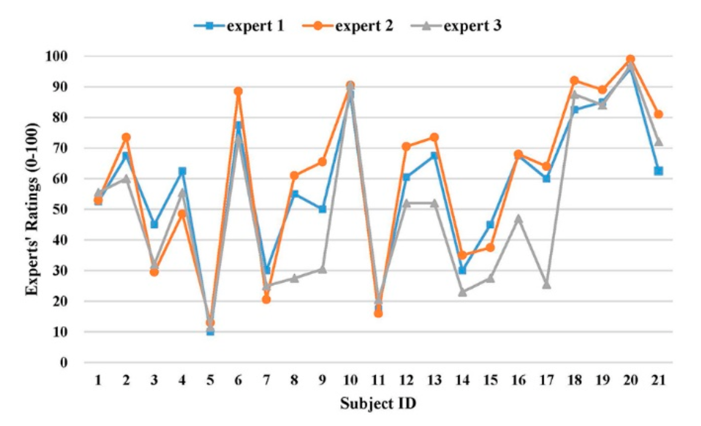
Results
Inter-Rater Reliability of Experts’ Ratings
The ICC(Intraclass Correlation Coefficient) value for three experts was 0.861 (95% CI: 0.688~0.942), which was within the range of 0.75 to 0.9, which indicates the experts’ ratings were consistent and with good inter-rater reliability.
ICC < 0.5: poor reliability
0.5 < ICC < 0.75: moderate reliability
0.75 < ICC < 0.9: good reliability
ICC > 0.9: excellent reliability
ICC介绍:
https://en.wikipedia.org/wiki/Intraclass_correlation

Slide 13
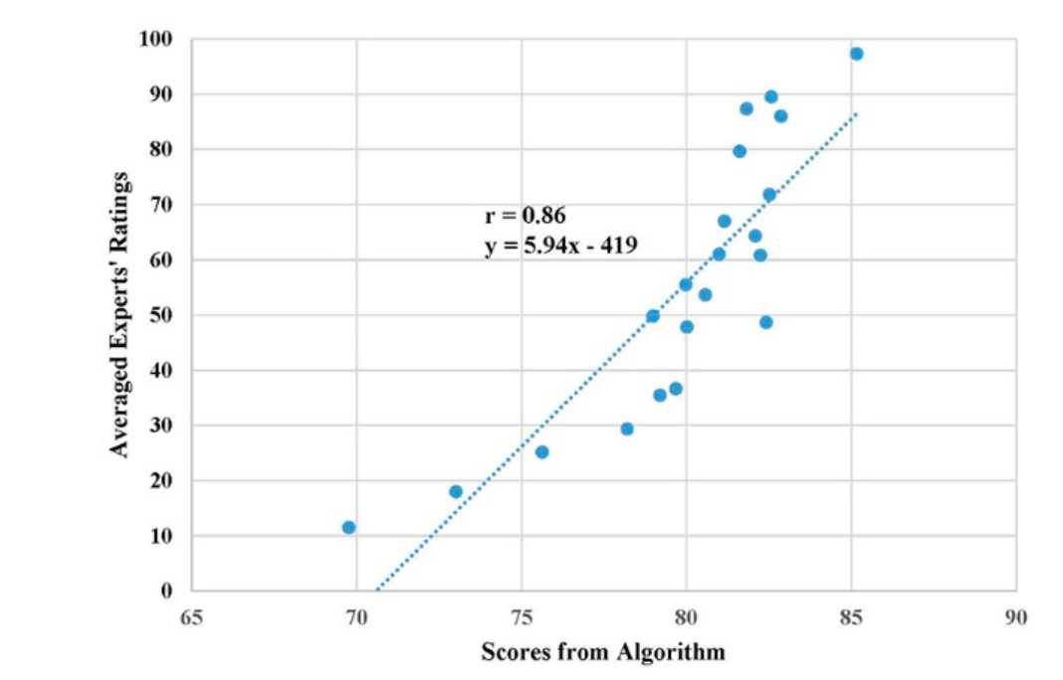
Results
Evaluation Comparison between Experts and the Developed Algorithm
the scatter plot of the algorithm’s final performance scores and averaged experts’ ratings for 21 subjects.
The Pearson correlation coefficient (r) was 0.86 (t = 7.45, p < 0.001), which indicates a strong positive linear relationship between scores from those two evaluation methods.
Under many circumstances, the algorithm would overestimate the performance when compared with the experts’ rating.
calibrated performance scores of the algorithm using the fitted equation from linear regression so that the algorithm would generate similar evaluation scores as the domain experts for practical applications

Slide 14
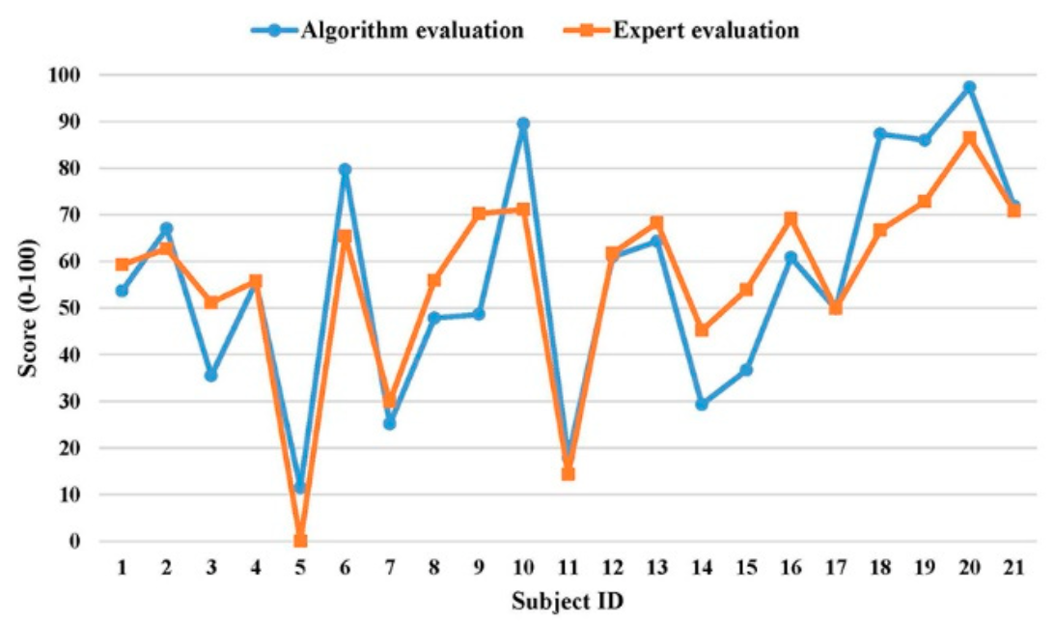
Results
Evaluation Comparison between Experts and the Developed Algorithm
The score difference between two evaluation methods had a mean of 9.5 and a standard deviation of 7.0 (Maximum: 21.6, Minimum: 0.1).

Slide 15
Discussion
We developed a DTW-based algorithm for assessing motion similarity between an individual user and a virtual coach.
The Tai Chi exercise was chosen as the representative physical exercise due to two reasons:
1. Tai Chi exercise for improving physical functions has be proven by many previous studies.
2. Tai Chi exercise is a complex and whole-body motion. If the algorithm could perform well in terms of evaluating Tai Chi motion, it should be generalizable to other simpler rehabilitation exercises.
We calculated the joint positions and bone vectors based on the local coordinate system of the human model instead of the world coordinate system in real-time, which can get rid of the error induced by the body orientation offset during the entire exercise.
Inter-rater reliability analysis revealed that the reliability level of experts’ ratings was “good” (0.75 < ICC = 0.861 < 0.90).
Strong linear relationship (r = 0.86) between the algorithm score and experts’ evaluation (gold standard) implied the developed algorithm was sensitive in terms of recognizing the performance levels from different subjects as the domain experts.
This could be mainly due to different baselines for two evaluation methods.

Slide 16
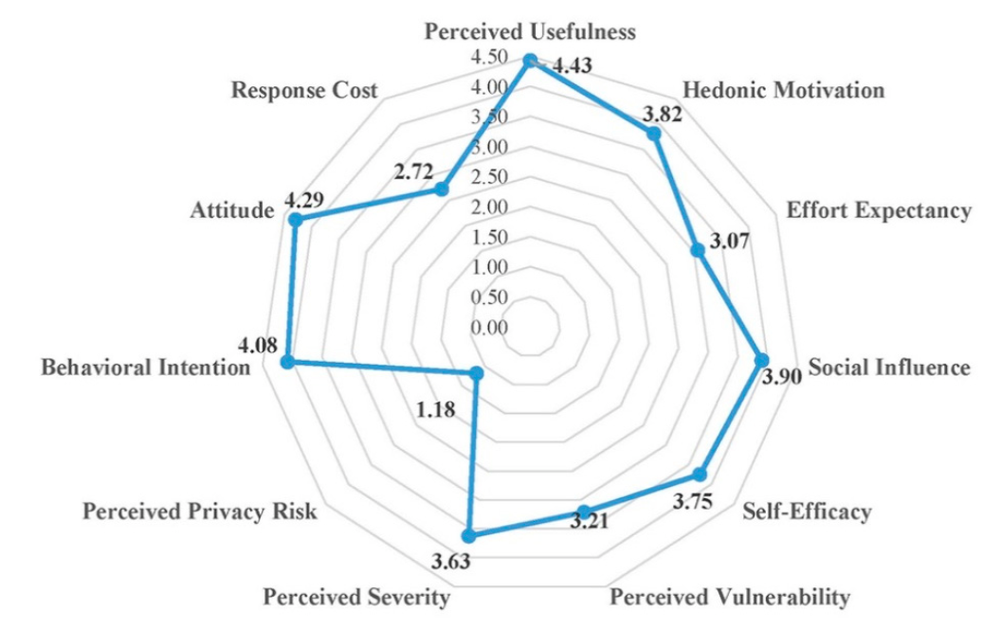
Discussion
In order to further examine the use and acceptance of exergaming technology for home-based physical rehabilitation by the primary target users (older people), we applied the technology acceptance model and designed a questionnaire with 11 constructs (Appendix A) to evaluate user acceptance of our developed Tai Chi exergaming prototype system.
Forty-one older adults (age 77.3 ± 5.4 years, height 159.3 ± 8.5 cm, weight 59.0 ± 9.5 kg) from a local senior welfare center participated in this survey.
These findings implied that our developed Tai Chi exergaming prototype system is useful for the older people performing home-based physical rehabilitation exercises.

Slide 17
Discussion
We collected some valuable feedback from the participants to improve our prototype system, which mainly includes the following:
(1) Audio effects should be added to make the exergame more entertaining and enjoyable.
(2) The standard pace of Tai Chi exergame should slow down and be adjustable by each individual.
(3) The size of avatar should be enlarged to be seen clearly and timely feedback for problematic motions should be provided.
(4) social networking functions (such as sharing exergaming performance score with friends) should be further developed.
There were several limitations in the current study:
(1) the conversion from DTW distance to a percentage score (0-100%) is based on the assumption that the maximum angle difference between two corresponding bone vectors is 90 degrees (not always appropriate).
(2) The rhythm mismatch was not yet considered in the overall performance evaluation. In addition, detailed feedback for problematic motions from certain body parts should be provided to timely inform the older individual for further improvements in rehabilitation exercises.
(3) refine the developed prototype system and test it with a large number of older adults at the home environment for verifying practicality of the system.
(4)a single Kinect sensor often generates poor skeleton tracking performance for some rotational motions during rehabilitation exercises due to self-occlusion and limited sensing range. Further research on combining data from multiple Kinect sensors to achieve more accurate and robust skeleton tracking performance is needed.

Slide 18
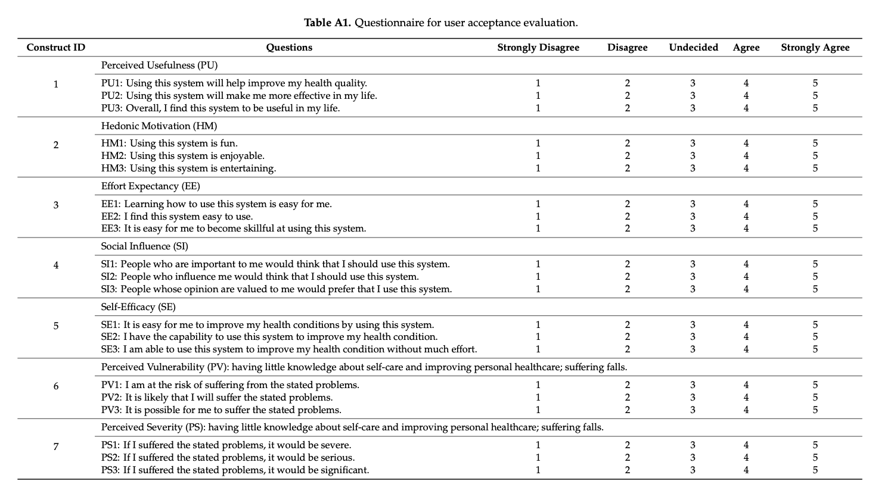
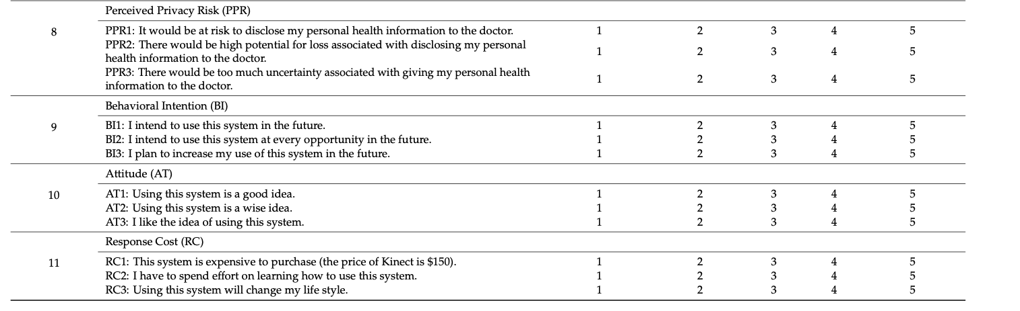

Slide 19
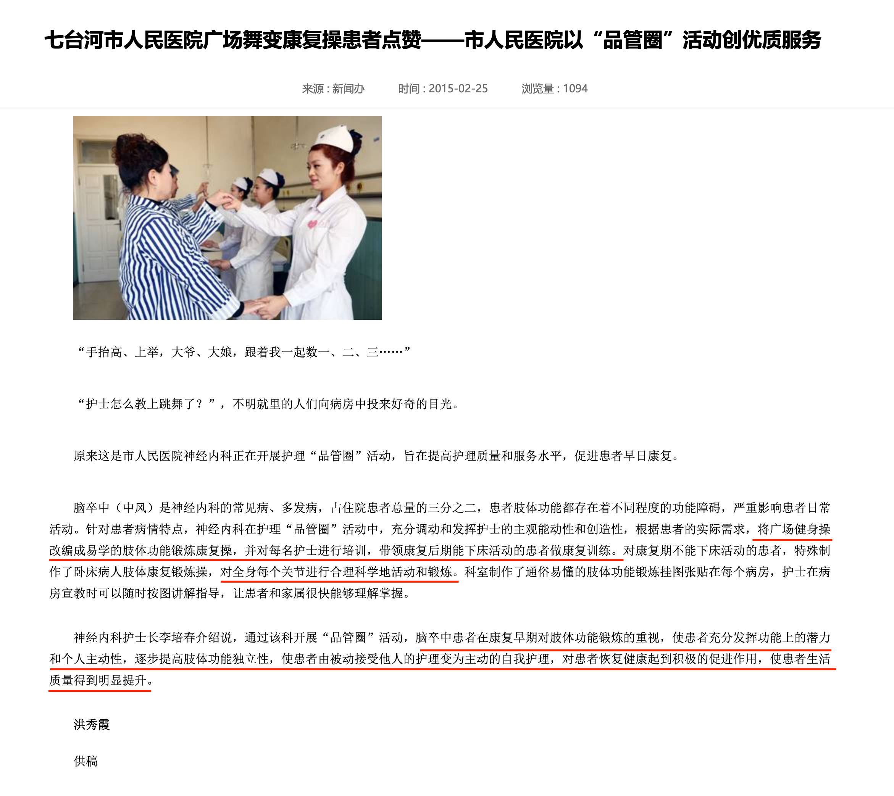

1. 加一些动态的场景（广场舞）
2. 用多个Kinect体感摄像头实现真正360度运动捕捉系统
（三个体感摄像头间隔120度就可以覆盖360度的全空间范围）
https://blog.csdn.net/artgolf/article/details/83104268
http://www.mesh-online.net/mocap.html

